Slide 1


Introduction to Quest
Janna Nugent, Sr. Computational Biology Specialist
NUIT Research Computing
Please set up your screen to have Zoom on one half of the screen and a terminal or web browser on the other half.

Slide 2
How this workshop will work
Interactive sections mixed with slides
Slides will be available after the workshop
Please ask questions in the chat or “Raise Hand” for help (button under “Participants”)
Two 5 minute breaks
This workshop is being recorded
Please set up your screen to have Zoom on one half of the screen and a terminal or web browser on the other half.

Slide 3

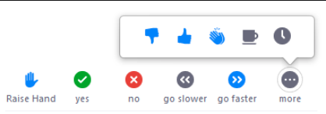
“Raise Hand” if you don’t have a Quest account
Please set up your screen to have Zoom on one half of the screen and a terminal or web browser on the other half.
Click here
Click

Slide 4
Please set up your screen to have Zoom on one half of the screen and a terminal or web browser on the other half.
Learn About
Research Computing
Quest System Architecture
Research Allocations on Quest
Parallel Computing
File Sharing
Getting Started:logging in, batch & interactive job submission

Slide 5


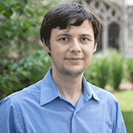

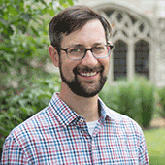
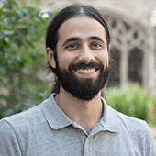


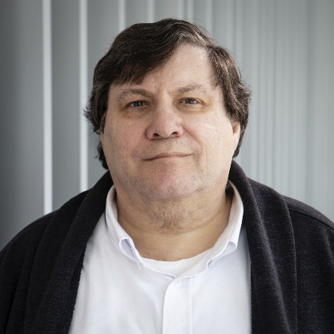
Please set up your screen to have Zoom on one half of the screen and a terminal or web browser on the other half.
Research Computing: the Consultants
We are a team under Northwestern Information Technology with research backgrounds in:
Social Sciences
Computer Science
Materials Science
Engineering
Astrophysics
Data Science
Bioinformatics
Cloud Computing
Data Workflow
Data Management
Visualizations
quest-help@northwestern.edu

Slide 6
Please set up your screen to have Zoom on one half of the screen and a terminal or web browser on the other half.
Research Computing: the Consultants
Alper Kinaci
We are a team under Northwestern Information Technology with research backgrounds in:
Social Sciences
Computer Science
Materials Science
Engineering
Astrophysics
Data Science
Bioinformatics
Cloud Computing
Data Workflow
Data Management
Visualizations
Janna
Nugent
quest-help@northwestern.edu

Slide 7
“Raise Hand” if you don’t have a Quest account
Please set up your screen to have Zoom on one half of the screen and a terminal or web browser on the other half.
Click here
Click

Slide 8
Please set up your screen to have Zoom on one half of the screen and a terminal or web browser on the other half.
Login to Quest
Make sure you’re connected to Northwestern’s VPN
From browser: http://quest.northwestern.edu:3000

Slide 9
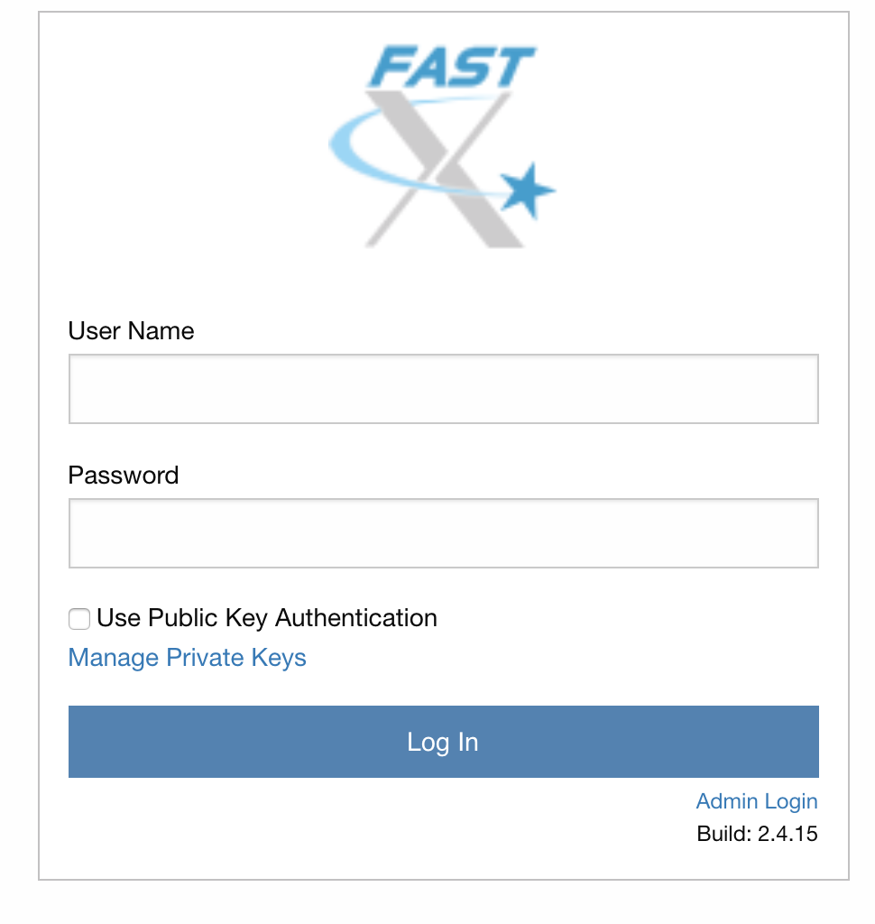
Login to Quest
http://quest.northwestern.edu:3000
If you don’t see this, check you’re on the VPN

Slide 10
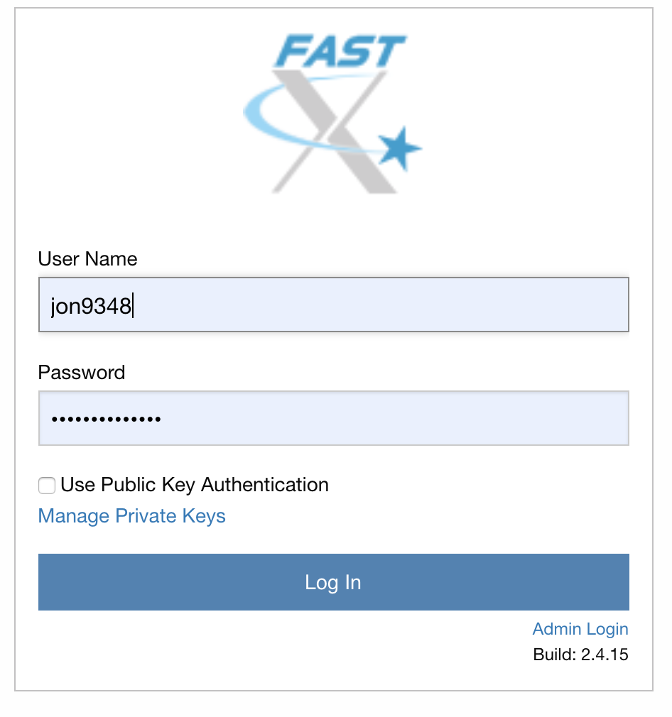
Login to Quest
http://quest.northwestern.edu:3000
If you don’t see this, make sure you’re on the VPN

Slide 11
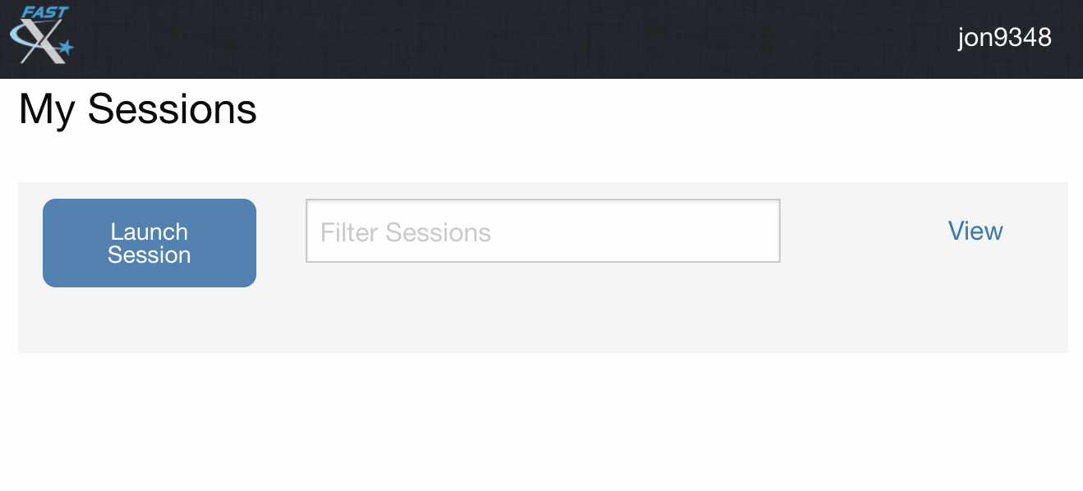
Login to Quest
http://quest.northwestern.edu:3000
Click
Click the “Launch Session” button

Slide 12
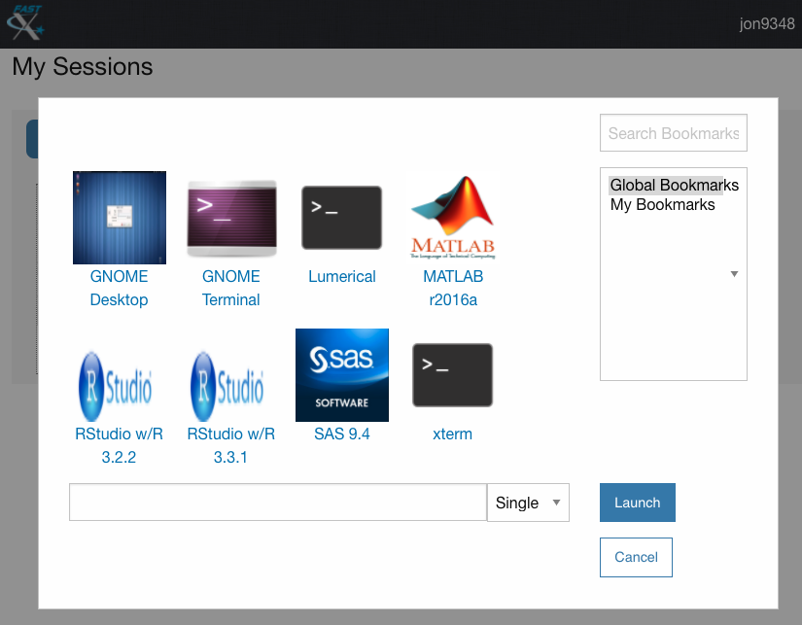
Login to Quest
http://quest.northwestern.edu:3000

Slide 13
Login to Quest
http://quest.northwestern.edu:3000
1) Select
2) Click

Slide 14
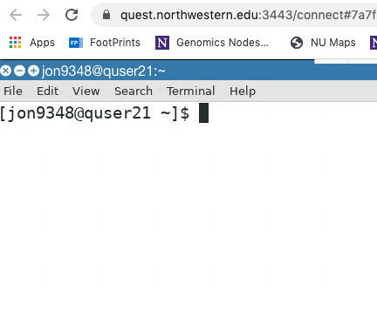
Login to Quest
http://quest.northwestern.edu:3000
Success!

Slide 15
“Raise Hand” if you
can’t login
Please set up your screen to have Zoom on one half of the screen and a terminal or web browser on the other half.
Click here
Click

Slide 16
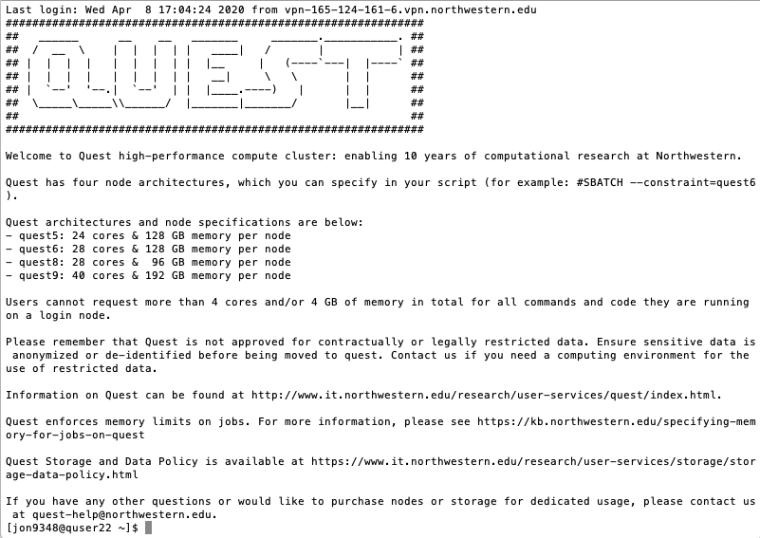

Slide 19
high-performance compute cluster

Slide 20

high-performance compute cluster
750 computers

Slide 21
high-performance compute cluster
computer = “node”
nodes in racks
Notes:
over 100TB of RAM total

Slide 22
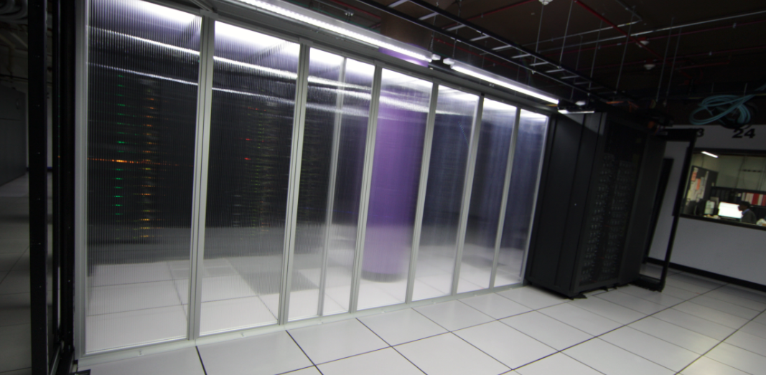
high-performance compute cluster
QUEST
Notes:
over 100TB of RAM total

Slide 23
high-performance compute cluster
750 nodes

Slide 24
high-performance compute cluster
1
750
 | Desktop Computer | Quest Node
Processor Speed | 2.2 MHz | 2.5 - 3.3 MHz
Cores | 2-4 | 24-40
Memory (RAM) | 8 Gb | 96-192 Gb
Quest has 25,000 cores
Notes:
over 100TB of RAM total

Slide 25
high-performance compute cluster
Each of the 750 nodes has 24-40 cores
Cores can also be called processors or CPUs
- they are what a thread or a task runs on

Slide 26
high-performance compute cluster
Each node can run jobs from
24-40 researchers at once
Python
R
Vasp
Fortran
MatLab
MatLab
R
Python
GATK
GATK
GATK
Python
R
Perl
MatLab
A job consists of a pre-packaged sequence of
commands run on a node for a user

Slide 27
high-performance compute cluster
Each node can run jobs with 24-40 threads at once, using all of the cores and memory of the node
R
R
R
R
R
R
R
R
R
R
R
R
R
R
R
R

Slide 28
high-performance compute cluster
Each researcher can run thousands of jobs at once and can have up to 5,000 jobs waiting to run at any time
R
R
R
R
R
R
R
R
R
R
R
R
R
R
R
R
Multiple independent jobs parallel computing:
High-throughput

Slide 29
high-performance compute cluster
R
R
R
R
R
R
R
R
R
R
R
R
R
R
R
R
R
R
R
R
R
R
R
R
R
R
R
R
R
R
R
R
R
R
R
R
R
R
R
R
R
R
R
R
R
R
R
R
R
R
R
R
R
R
R
R
R
R
R
R
R
R
R
R
1 job, multiple nodes parallel computing: OpenMP, MPI

Slide 31
high-performance compute cluster
Node Architectures: 4 Generation of Nodes
128 GB RAM (Q5, Q6)
96 GB RAM (Q8)
192 GB RAM (Q9)
Q5 → 24 cores/node
Q6 → 28 cores/node
Q8 → 28 cores/node
Q9 → 40 cores/node
Q5
Q6
Q8
Q9

Slide 33

Quest: High Performance Compute Cluster
compute nodes
login nodes
quser21
quser22
quser23
quser24

Slide 34
Login to Quest
http://quest.northwestern.edu:3000
Success!

Slide 35
Quest: High Performance Compute Cluster
compute nodes
login nodes
quser21
quser22
quser23
quser24

Slide 36
Interactive on Quest

Slide 37
BREAK

Slide 40
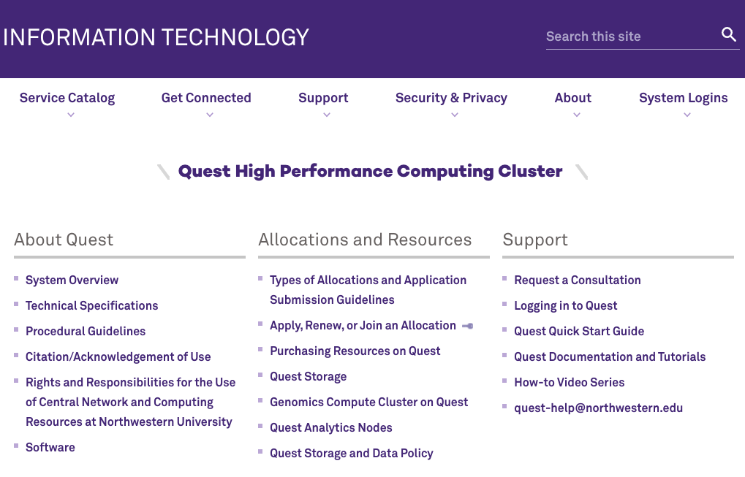

Slide 44
Interactive on Quest

Slide 45
Quest: High Performance Compute Cluster
compute nodes
Scheduler
login nodes
quser21
quser22
quser23
quser24

Slide 46


The Scheduler
login node
compute node
“sbatch submit.sh”
compute node
compute node
scheduler
compute node
#SBATCH -A <allocationID>
#SBATCH -p <queue_type>
#SBATCH -N 1
.
.
compute node

Slide 47
Account vs. Allocation

Slide 48
Account
Private
/home/<netID>
Backed up
80Gb storage quota

Slide 49
Allocation
Group
Shared access to time on the compute nodes
Shared storage: /projects/<allocation>
Not backed up

Slide 50


Allocation Types: General Access
Research I Allocation, 500GB storage
computational need < 100K hour
Research II Allocation, 2TB storage
computational need > 100K hour
Classroom Allocation, 500GB storage
computational need < 100K hour
3.5 PB
Infiniband
/projects/p123xx
http://www.it.northwestern.edu/research/user-services/quest/allocation-guidelines.html

Slide 51

Allocation Types: Buy-in
Full access to compute nodes & persistent storage for 5 years
Buy-in nodes
3.5 PB
Infiniband
/projects/b1xxx
http://www.it.northwestern.edu/research/user-services/quest/full-access.html

Slide 52
Genomics Compute Cluster
Allocation b1042
Dedicated to genomics research
Free to all genomics researchers at Northwestern
2,600 cores
Dedicated high-memory nodes
175 Tb of scratch space
http://www.it.northwestern.edu/research/user-services/quest/genomics.html

Slide 53
Analytics Nodes
The Quest Analytics Nodes allow users to run RStudio, Jupyter Notebooks and SAS Studio in their web browser, backed by Quest file systems and nodes with more computational resources than available on a personal computer. They are available to all Quest users with an active allocation.

Slide 54
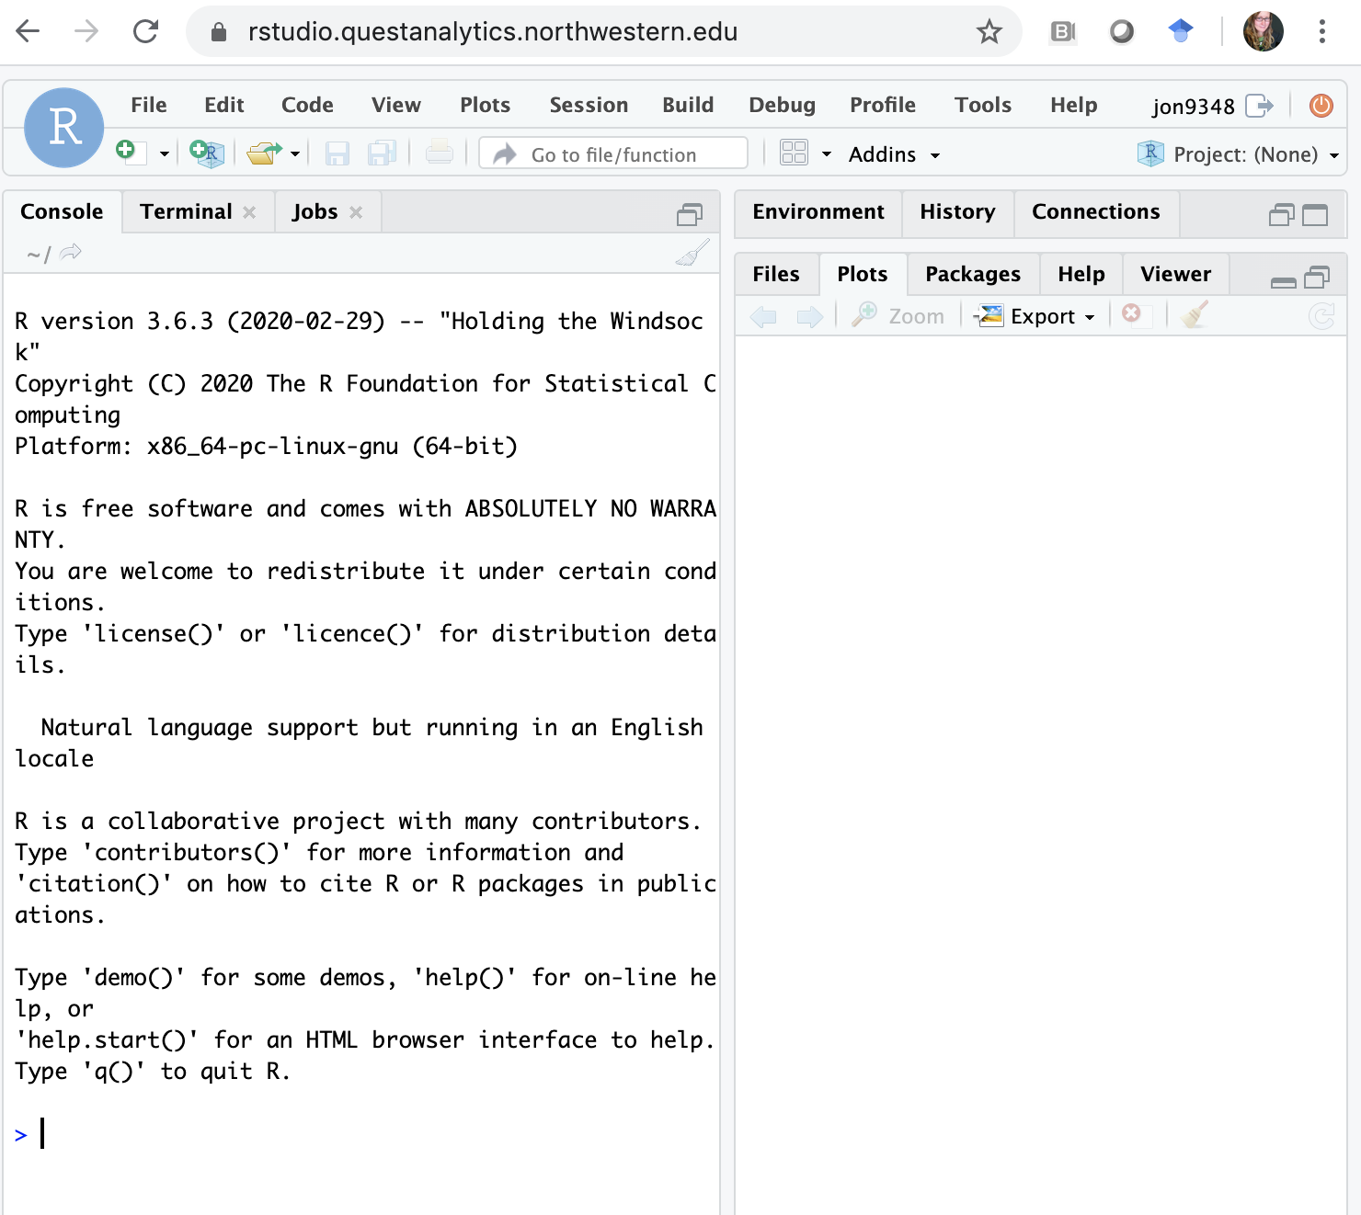
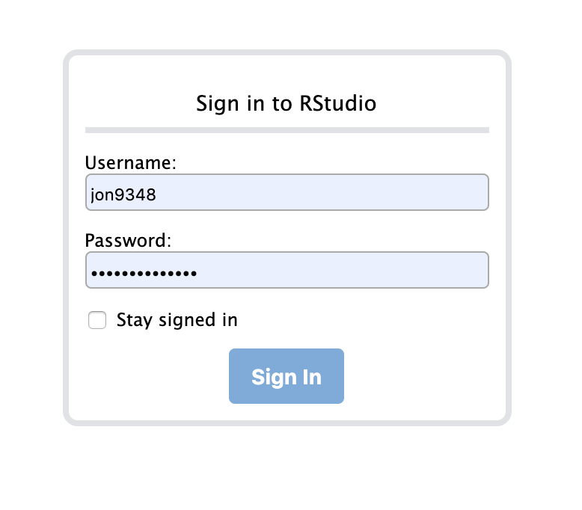
https://rstudio.questanalytics.northwestern.edu
R 3.6.3

Slide 55
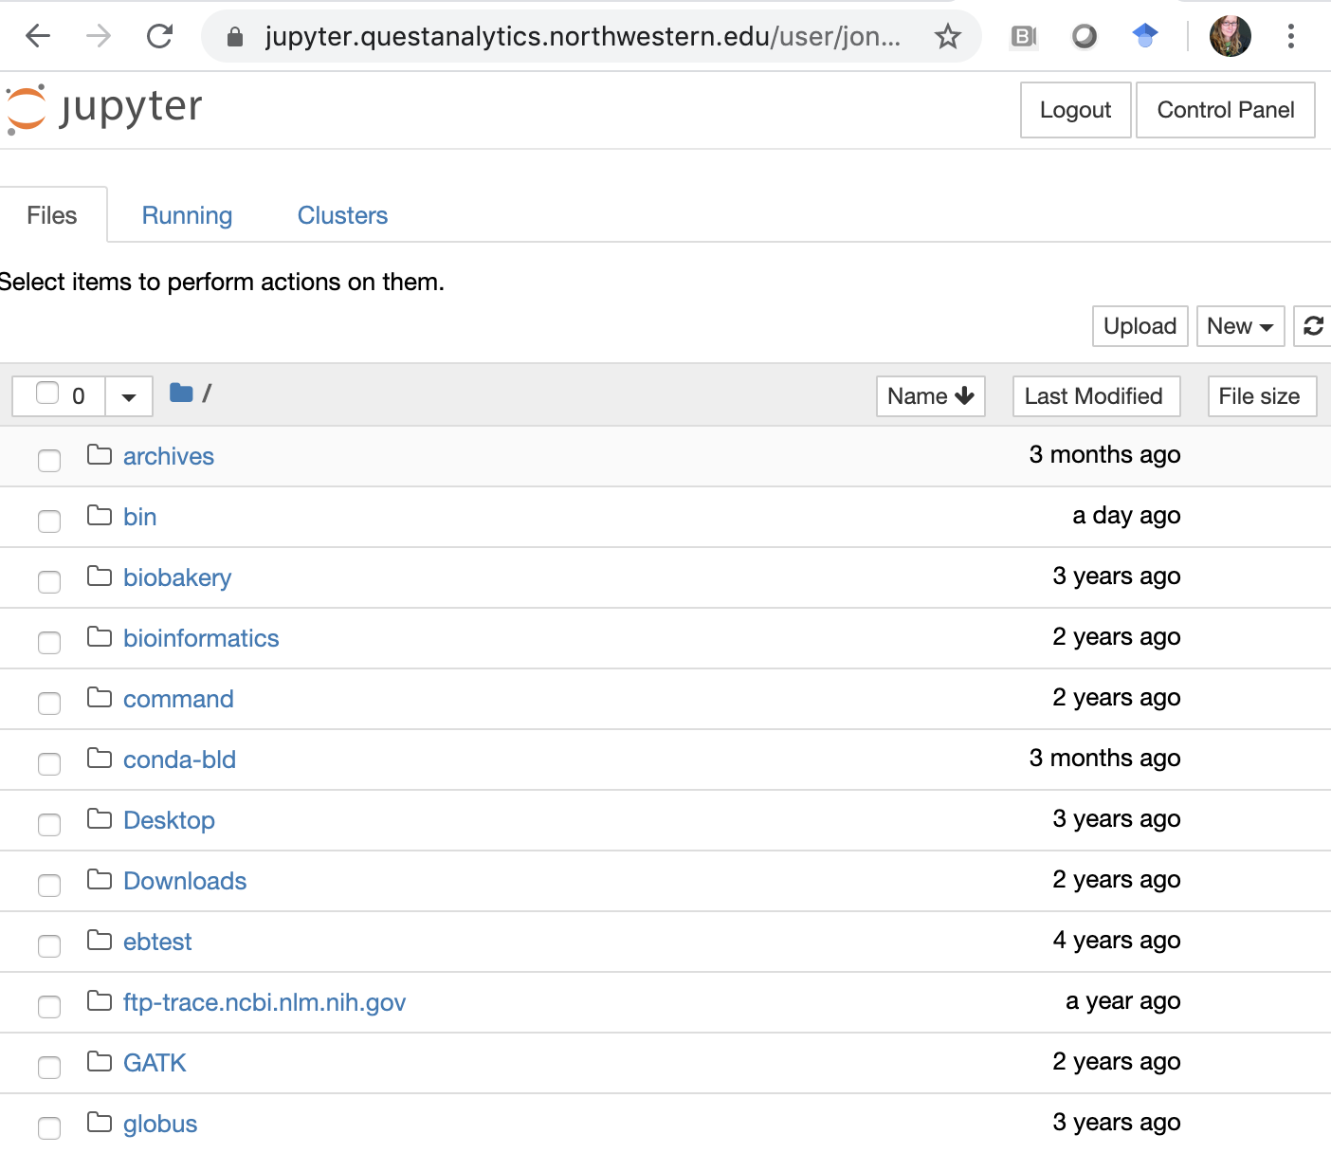
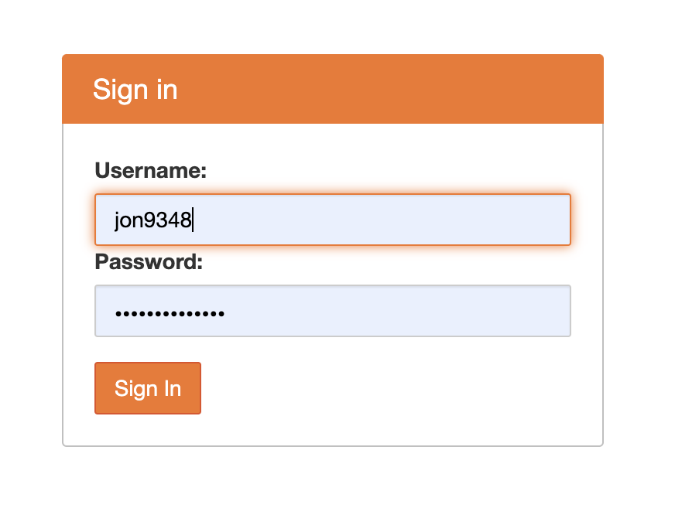
https://jupyter.questanalytics.northwestern.edu
Python 3.7.1

Slide 56
High-Memory Nodes
GPU Nodes
kb.northwestern.edu
search for “Quest Partitions/Queues”

Slide 57
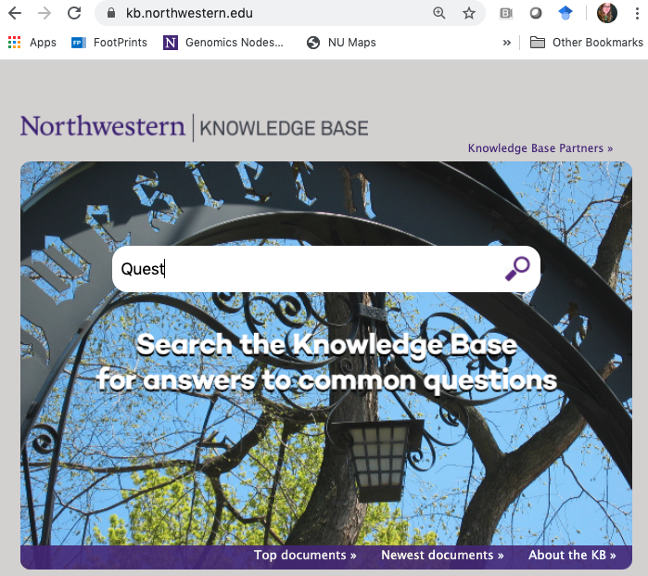

Slide 58
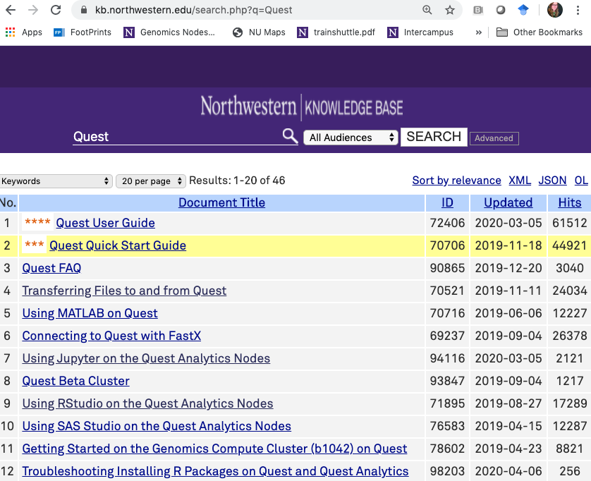

Slide 59
Quest: High Performance Compute Cluster
Backing up your data
Northwestern Box: unlimited, free, 15GB single file limit
RDSS (Research Data Storage Service)
& FSMRESfiles (for Feinberg research)
Amazon AWS
Other cloud options

Slide 60

globus.org

Slide 61
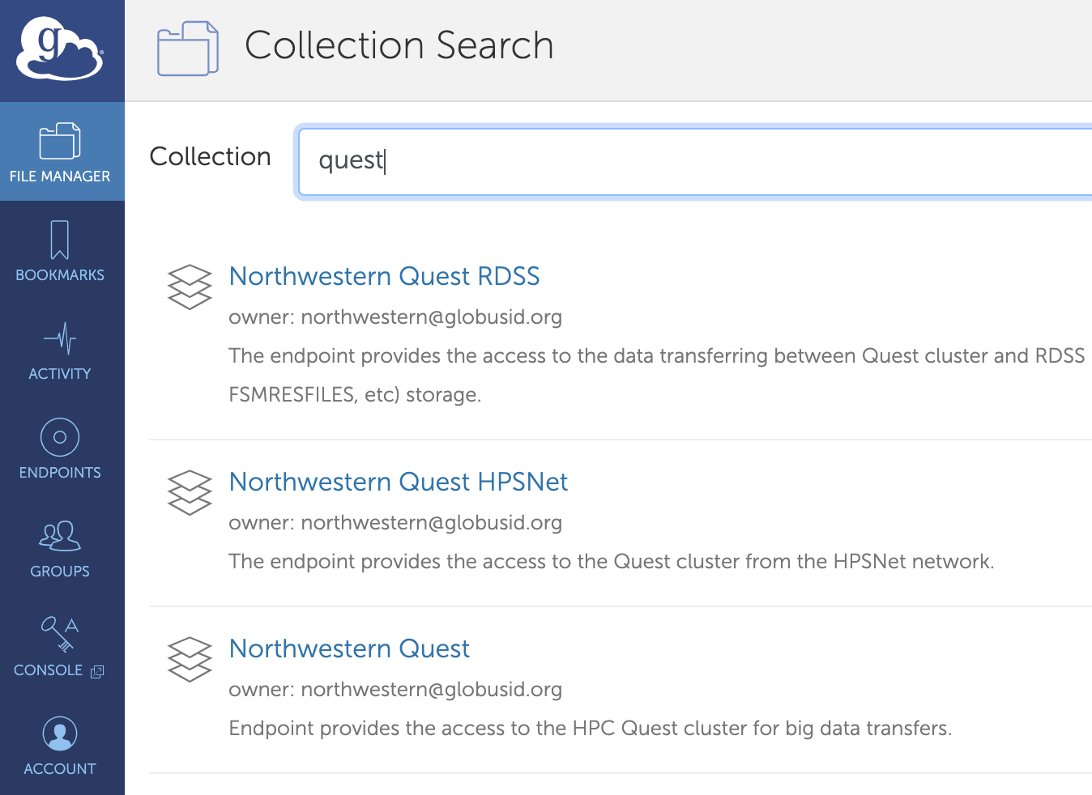

Slide 62
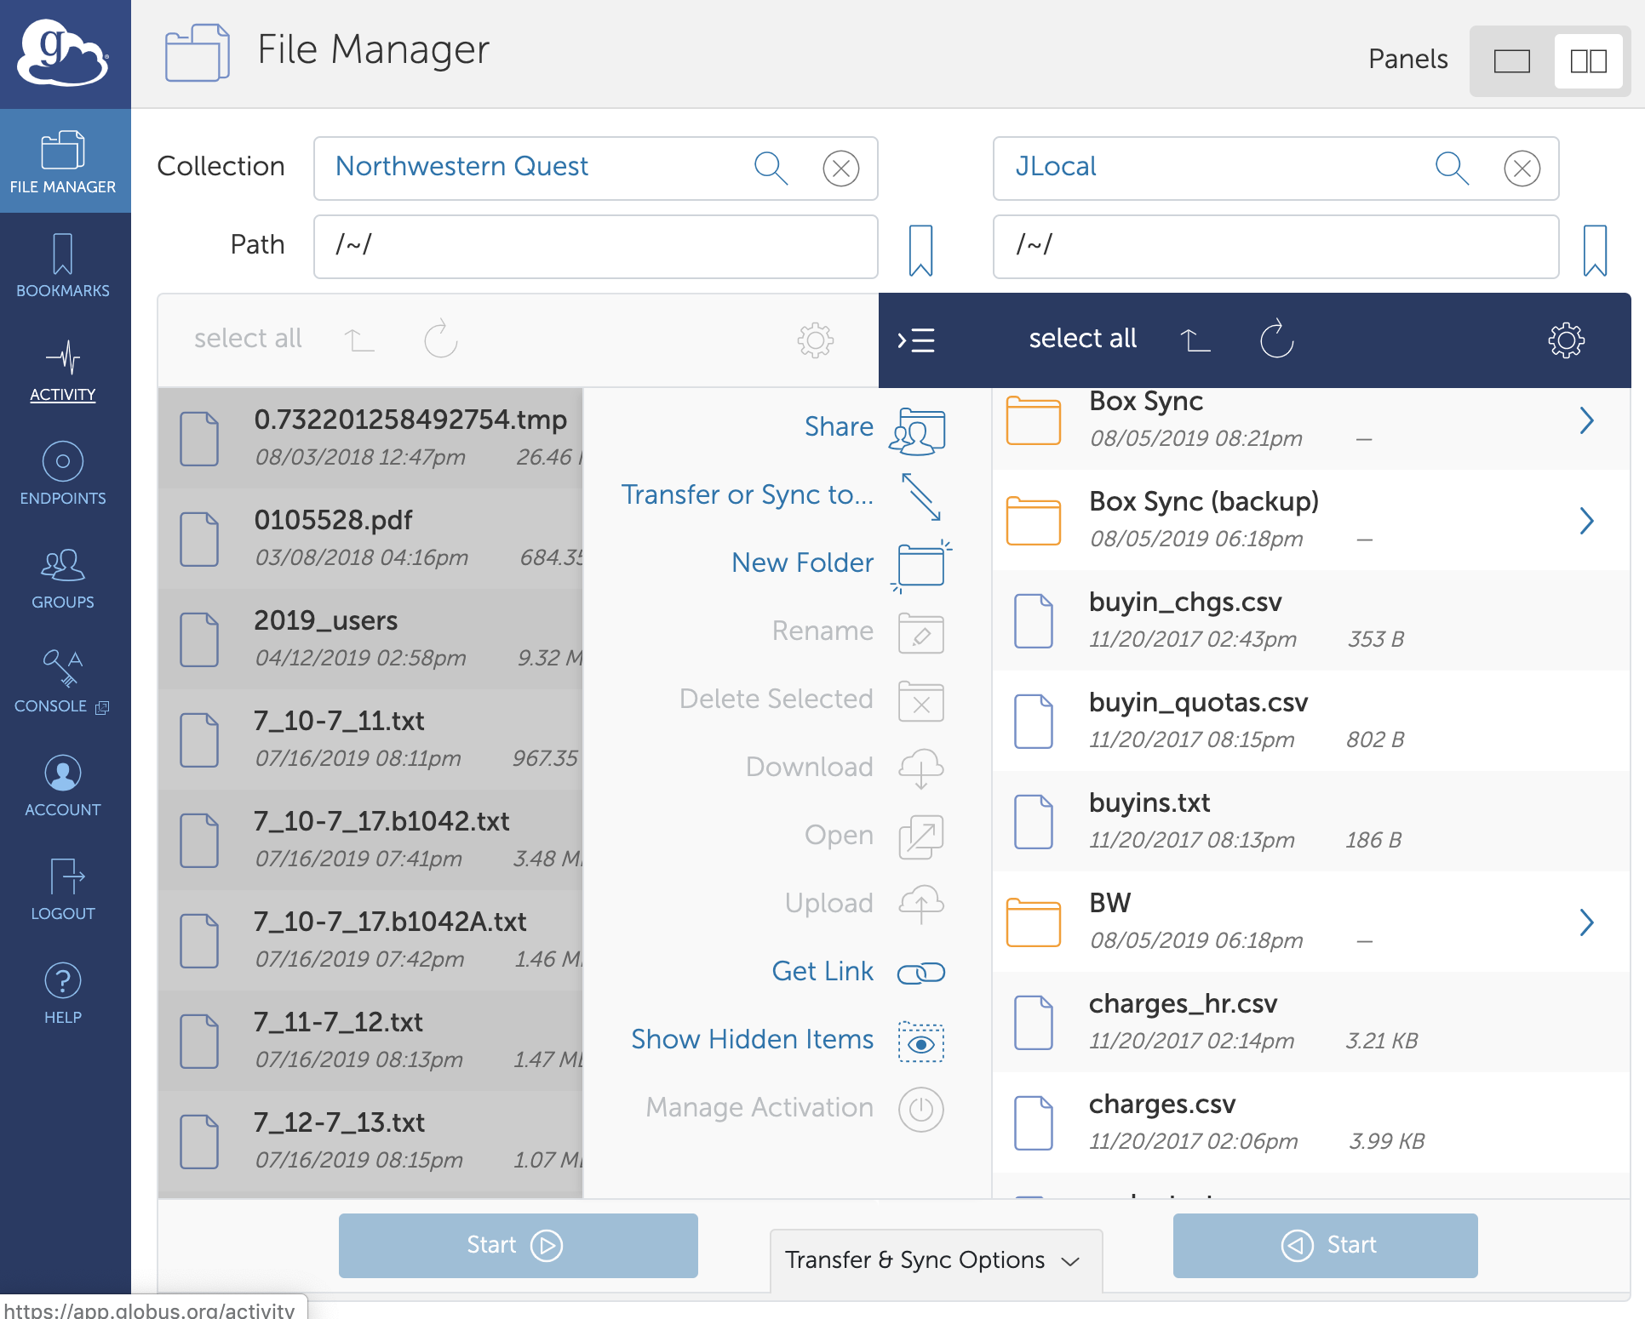

Slide 63
BREAK

Slide 64
“Raise Hand”
Please set up your screen to have Zoom on one half of the screen and a terminal or web browser on the other half.
Click here
Click

Slide 65
Getting Started: Batch Job Submission
What is the scheduler looking for in your script?
Behold, this is a BASH script:
#!/bin/bash
#SBATCH -A p20XXX
#SBATCH -p short
#SBATCH –N 1
#SBATCH –ntasks-per-node=1
#SBATCH –t 04:00:00
#SBATCH --mem-per-cpu=1G
#SBATCH -J sample_job
#SBATCH -o outlog
#SBATCH -e errlog
Account:
Partition/Queue:
Number of nodes:
Number of cores:
Length of the job:
Required memory:
Name of the job:
Generate an output log:
Generate an error log:

Slide 66
Getting Started: Batch Job Submission
submit_generic_slurm.sh
#!/bin/bash
#SBATCH --account=<allocationID> ## <-- EDIT THIS TO BE YOUR ALLOCATION
#SBATCH --partition=<queue_type> ## <-- EDIT THIS TO BE YOUR partition NAME
#SBATCH --nodes=1
#SBATCH --ntasks-per-node=1
#SBATCH --time=00:10:00
#SBATCH --mem-per-cpu=1G
#SBATCH --job-name=sample_job
#SBATCH --output=outlog
#SBATCH --error=errlog
module purge all ## Unload existing modules
module load python ## Load necessary modules (software, libraries)
bash whereami ## Run the program
python helloworld.py ## Run the program

Slide 67
Which partition should you use?
If your Allocation:
starts with “p” or “e” use “short”
starts with “b” use your Allocation name for example, for b1000 use partition “b1000”
is “b1042” use “genomics”
is “w10001” use “w10001”

Slide 68

text editor: nano
Getting Started: Batch Job Submission
$ nano submit_generic_slurm.sh this will open the named file for editing or create it if it doesn’t exist
type your text: the mouse will not move the cursor - navigate with the arrow keys
save and quit: commands are on the bottom of the screen - the “^” stands for “control”

Slide 69
Interactive on Quest

Slide 70
Questions?
Help email: quest-help@northwestern.edu
Research Computing Services

Slide 71
Python package installation
$ module load python
This will load a development level version of python (2.7) in your environment
$ pip install –user tensorflow –upgrade
Install the package - check in /home/netID/.local
Start python and to test type : import tensorflow as tf
You can exit python by typing: quit() and press enter

Slide 72
R package installation
$ module load R/3.4.3
This will load a development level version of R (3.4.3) in your environment
$ R (enter the R interpreter environment)
> install.packages(‘tensorflow’)
You can click yes to all the options
Check by typing: library(‘tensorflow’)
Exit by typing: quit() and then type n (for no)
Installations will be in home directory under: /home/netid/R/x86_64-pc-linux-gnu-library/3.4/

Slide 73
Build your own package/libraries: fftw
Create a directory and download:
$ mkdir csr; cd csr; wget http://www.fftw.org/fftw-3.3.7.tar.gz
Unpack: $ tar –xvmf fftw-3.3.7.tar.gz
Enter package directory, configure and build
$cd fftw-3.3.7 ; ./configure –prefix=/home/netID/fftw_install ; make ; make install
Inspect installation: $ ls fftw_install
Installation contains directories bin include lib share
Add environmental variables in your /home/netID/.bashrc file:
export $PATH=/home/netID/fftw_install/bin:$PATH
export $LD_LIBRARY_PATH=/home/netID/fftw_install/lib:$LD_LIBRARY_PATH
export $PKG_CONFiG_PATH=$LD_LIBRARY_PATH/pkgconfig:$PKG_CONFIG_PATH

Slide 74
Build your code
Download a sample code that needs your libraries
$ wget http://geco.mines.edu/files/userguides/techReports/mklWrappers/fft_example/test.c
Compile:
$ gcc test.c -o test \
-L$HOME/fftw_install/lib -lfftw3 -lm \
-I$HOME/fftw_install/include
Run:
./test >& output
Compiler-Source-Exec
Linking to libraries
&headers

